Slide 1
Cyber security Essentials – EDR & Email Protection
Week 4 day 4 presentation
Presented By:- Kundan Gawande (28806)

Slide 2

Points to be Discussed
What is EDR?
How EDR Works
Benefits of EDR
What is Email Protection?
Types of Email Threats
Need for Email Protection
Email Security Best Practices
Conclusion

Slide 3
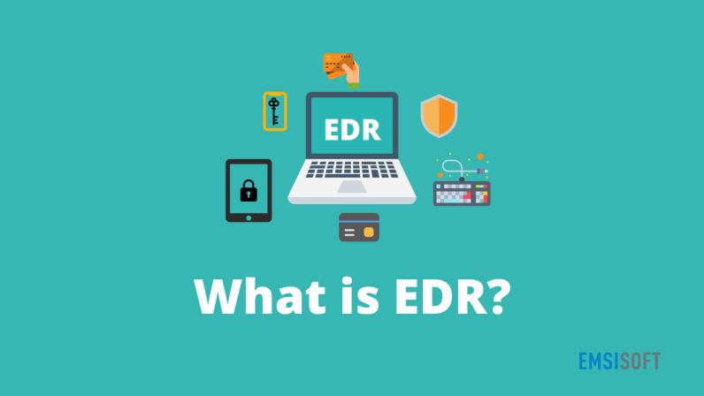
What is EDR?
Endpoint Detection and Response (EDR) is a cybersecurity technology that continuously monitors and responds to threats on endpoint devices such as laptops, desktops, and servers.
Key Features:
Real-time monitoring
Threat detection
Data collection & analysis
Automated response

Slide 4

How EDR Works
Data Collection – Gathers endpoint activity data.
Detection – Identifies suspicious behavior using AI and threat intelligence.
Investigation – Provides forensic tools to analyze incidents.
Response – Enables automated or manual threat mitigation.

Slide 5

Benefits of EDR
Early threat detection
Minimizes dwell time
Reduces impact of ransomware and malware
Forensic analysis capabilities
Compliance support (e.g., GDPR, HIPAA)

Slide 6

What is Email Protection?
Email protection refers to technologies and practices that secure email communications against threats like:
Phishing
Spam
Malware attachments
Business Email Compromise (BEC)

Slide 7

Why is Email Protection Needed?
90% of cyberattacks begin with email
Emails are the #1 attack vector
Phishing leads to data breaches and ransomware
Growing use of social engineering in attacks

Slide 8

Consequences
Financial loss
Data theft
Reputational damage

Slide 9
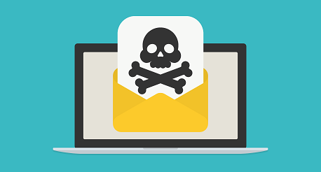

Common Email Threats
Phishing & Spear Phishing
Malicious Attachments & Links
Spoofing & Impersonation
Credential Harvesting
Zero-day exploits

Slide 10

Best Practices for Email Security
Use advanced email filtering (anti-spam/anti-phishing)
Implement DMARC, DKIM, SPF protocols
Enable Multi-Factor Authentication (MFA)
Regular user training and awareness
Keep software updated

Slide 11

Conclusion
EDR is vital for detecting and responding to endpoint threats
Email protection is crucial due to email's vulnerability
A multi-layered security approach reduces risk
Invest in technology and training for a secure environment

Slide 12


